Slide 1


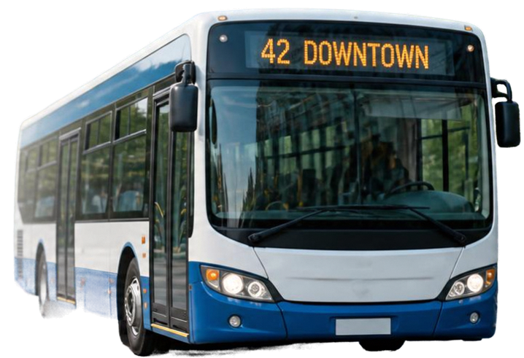



PUBLIC
TRANSPORT
COMPLAINT PORTAL
A MERN-based system for reporting and
managing transport issues
Presented by:
Y.Akshaya-25MVCSMR0274
M.Rajeshwari-25MVCSMR0239
D.Maithreyee-25MVCSMR0213
K.Eekshanika-25MVCSMR0236

Slide 2

PROBLEM AND SOLUTION OVERVIEW
THE CHALLENGE
OUR SOLUTION
Passengers need an efficient way
to report and track complaints about buses, routes, and locations.
A MERN stack web portal for seamless complaint management with
real-time updates.

Slide 3









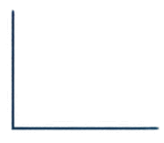

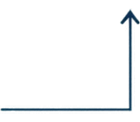

SYSTEM ARCHITECTURE
Built on the MERN stack for a scalable and efficient complaint management system.
FRONTEND
BACKEND
DATABASE
React.js
Express & Node.js
MongoDB
Interactive UI for passengers and administrators
REST API handling business logic and
CRUD operations
Stores buses, routes, complaints, locations, and statuses
DATA FLOW
Users submit complaints → API processes requests → Data stored and retrieved from MongoDB

Slide 4











CORE FEATURES &
CRUD OPERATIONS
FULL CRUD SUPPORT
CREATE
Manage bus fleet details and related information
BUSES
READ
Maintain routes, stops, and schedules with ease
ROUTES
UPDATE
Track and organize locations across the network
LOCATIONS
DELETE
Capture, manage, and resolve passenger complaints
COMPLAINTS
POWERED BY REST APIS
Monitor complaint status from submission to resolution
STATUS

Slide 5











AUTHENTICATION & ROLE-BASED ACCESS
SECURE SIGN-IN
Secure sign-in protects user accounts and data.
Commuters can report and view complaints.
Admins manage records and update complaint status.
COMMUTER
ADMIN
Report complaints
Manage all records
Role-based access keeps the system secure and reliable.
View complaint status
Update complaint status

Slide 6


SUMMARY & NEXT STEPS
The MERN stack powers a robust, scalable complaint portal
Streamlined complaint management drives better public transport service
Next steps: testing, deployment,
user training, and feedback collection
Together, we can build a better commute

Slide 7
THANKYOU!

